Slide 1
Data mining using Excel
Fatima GASMI | ESGI

Slide 2
Introduction
Fatima GASMI
Lead Data Scientist @ALLIANZ TRADE
Fatimazahrae.gasmi@gmail.com
Please put ESGI in the subject of your email

Slide 3
Index
Introduction
Collecting and Importing Data in Excel
Data tabs
Number and Formulas
First statistical approach
Data discovery and exploration
Visualizing data
Data Cleaning
Pivot Table / Charts and Slicers
Bivariate Analysis

Slide 4

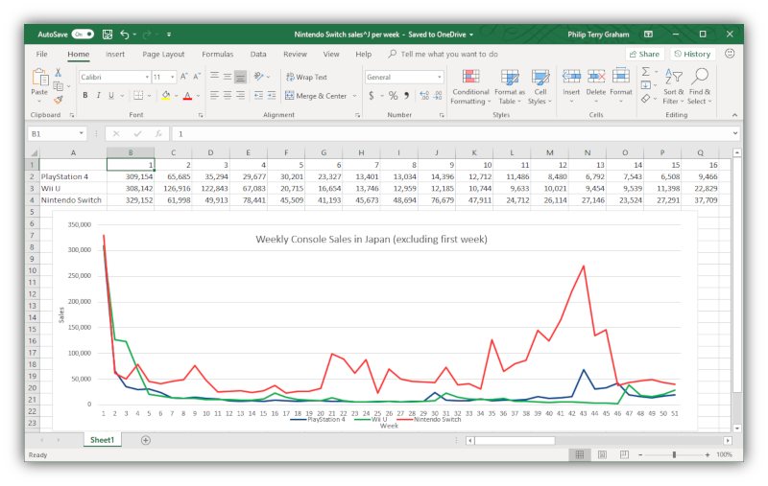
Introduction
What is Excel ?
Microsoft Excel is a spreadsheet developed by Microsoft for Windows, macOS, Android and iOS.
It features calculation or computation capabilities, graphing tools, pivot tables, and a macro programming language called Visual Basic for Applications (VBA)
Excel forms part of the Microsoft Office suite of software.

Slide 5

Introduction
What is Data Mining ?
“…the process of discovering meaningful new correlations, patterns, and trends by sifting through large amounts of data…” (Gartner Group)
“…the analysis of observational data sets to find unsuspected relationships and to summarize data in novel ways…” (Hand et al.)
“…is an interdisciplinary field bringing together techniques from machine learning, pattern recognition, statistics, databases, and visualization…” (Cabana et al.)
… is the exploration and analysis of large quantities of data in order to discover previously unknown meaningful and actionable patterns and rules (adapted form Berry and Linoff)

Slide 6
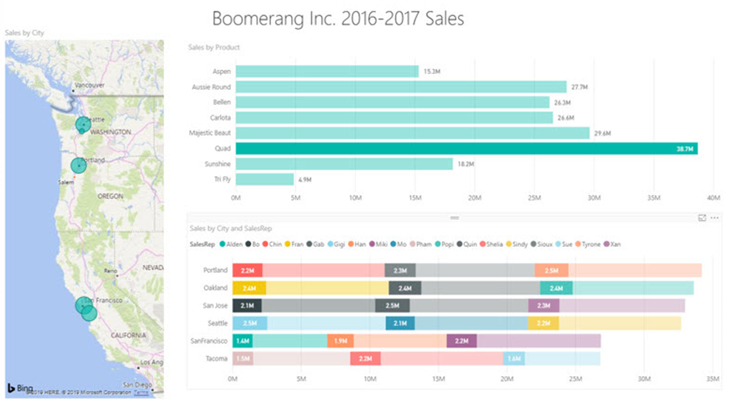
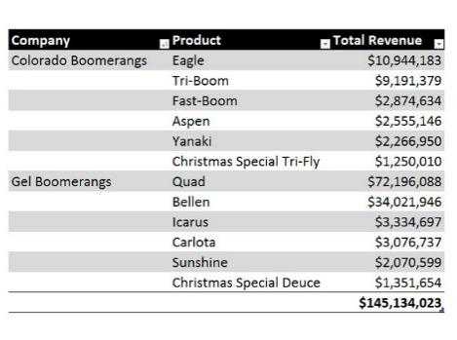




Introduction
Data Mining using Excel
Using Excel computing capabilities and features to Convert Raw Data into Useful Information for Decision Makers
Build Reports, Visualizations and Dashboards that Deliver Useful Information
Data Mining
Import Data in Excel
Collect Data
Clean & Transform Data
Build Data Model

Slide 7
Collecting Data
Relational databases, such as SQL Server, Oracle, MySQL, and IBM DB2, are used to store data in an organized manner in these systems. Data from databases and data warehouses can be utilized as an analysis source.
Data
Database
API
Open Data
Web Scraping
Web scraping is a technique for obtaining meaningful data from unstructured sources. Online scraping, allows to retrieve data from websites depending on predefined parameters.
APIs, or Application Program Interfaces, and Web Services are provided by many data providers and websites, allowing various users or programs to communicate with and access data for processing or analysis.
Open data is data that is openly accessible, exploitable, editable and shared by anyone for any purpose, even commercially. Open data is licensed under an open license.

Slide 8
Importing Data in Excel
Why importing Data ?
Cell by cell input is no longer suitable when a large amount of data must be processed. A standard input format is then necessary.
Multiple ways are available in Excel to enter bulk data in a spreadsheet :
TXT / CSV
XML
Web
Database

Slide 9
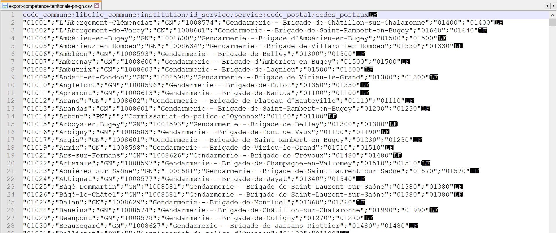
Importing Data in Excel
Importing CSV file – Part 1
One is the most common way to store data is to use the CSV format “Comma Separated Values".
A CSV file is a text file, containing data on each line separated by a separator character (usually a semicolon, comma, or tab).
Columns Headers are in the 1st line
Fields separator is semicolon

Slide 10
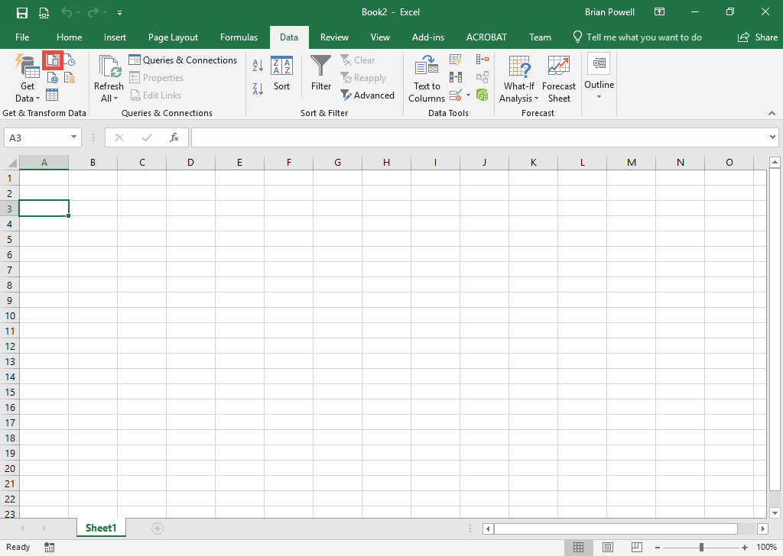
Importing Data in Excel
Importing CSV file – Part 2
Click the cell where you want to import the CSV file.
Go to the Data ribbon.
Click the From Text/CSV button.
Select the CSV file to import.
Click the Import button.
Click the Transform Data button.

Slide 11
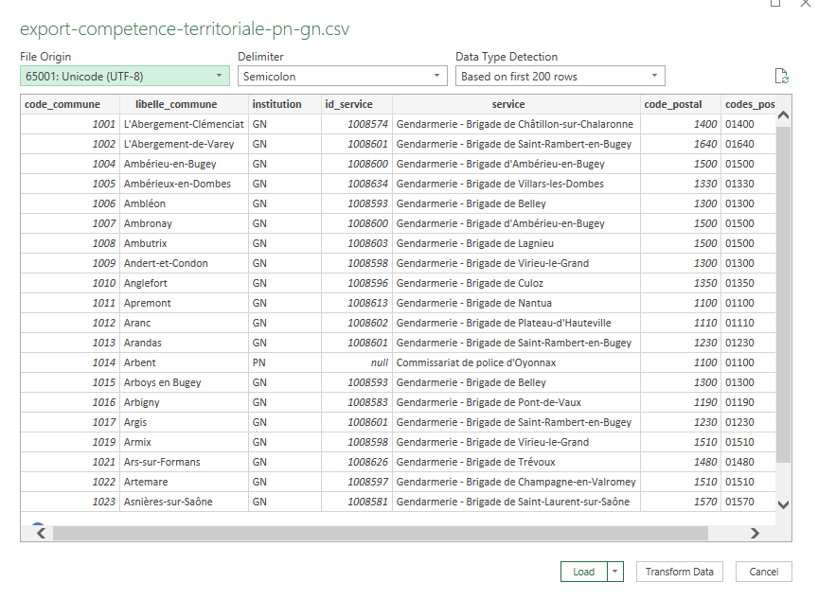
Importing Data in Excel
Importing CSV file – Part 3
Click the Transform Data button.

Slide 12
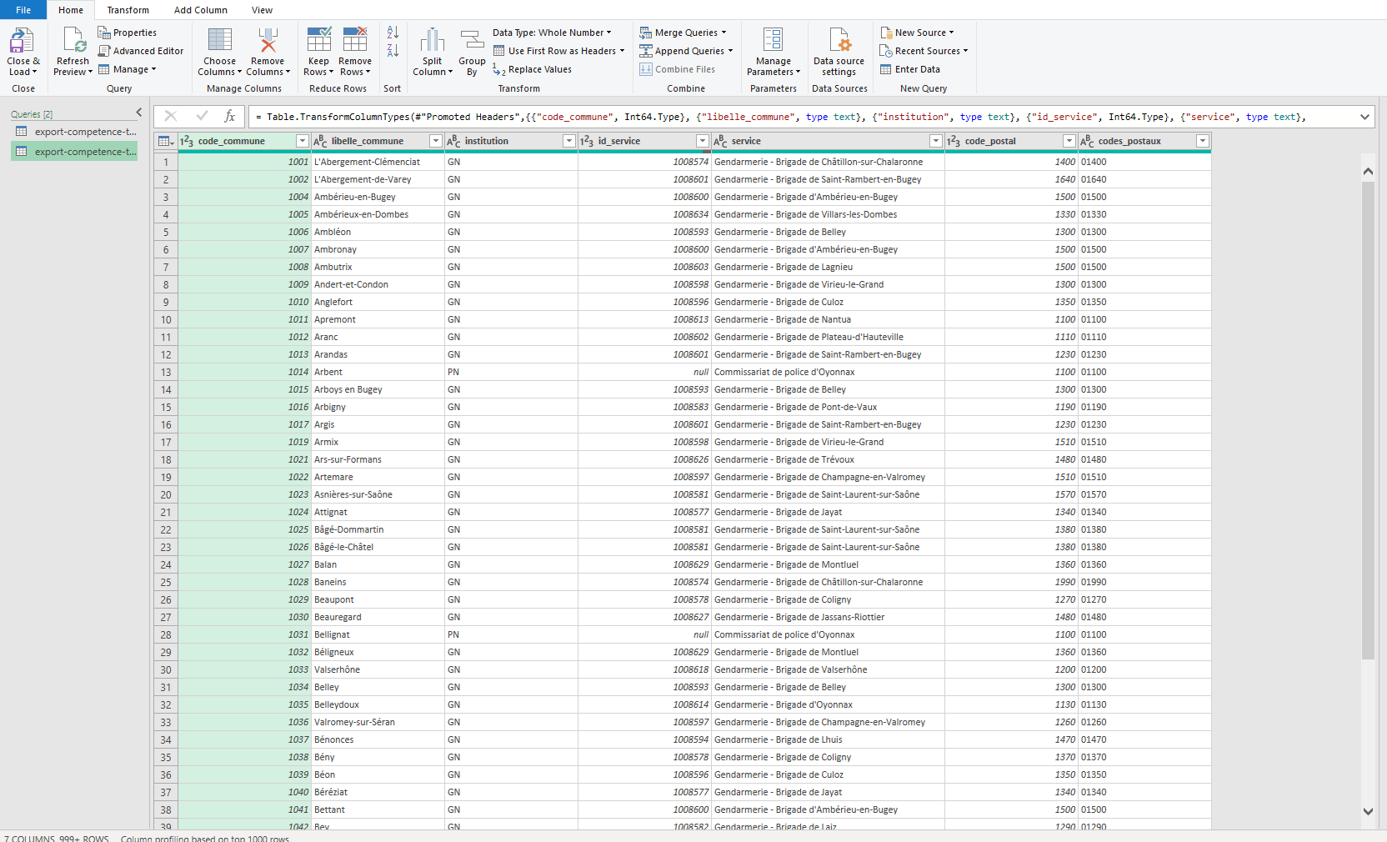
Importing Data in Excel
Importing CSV file – Part 4
Look at the table of data to ensure that the heading at the top contains names for the columns and not data.
If column headings aren’t shown, click the Use First Row as Headers button.

Slide 13
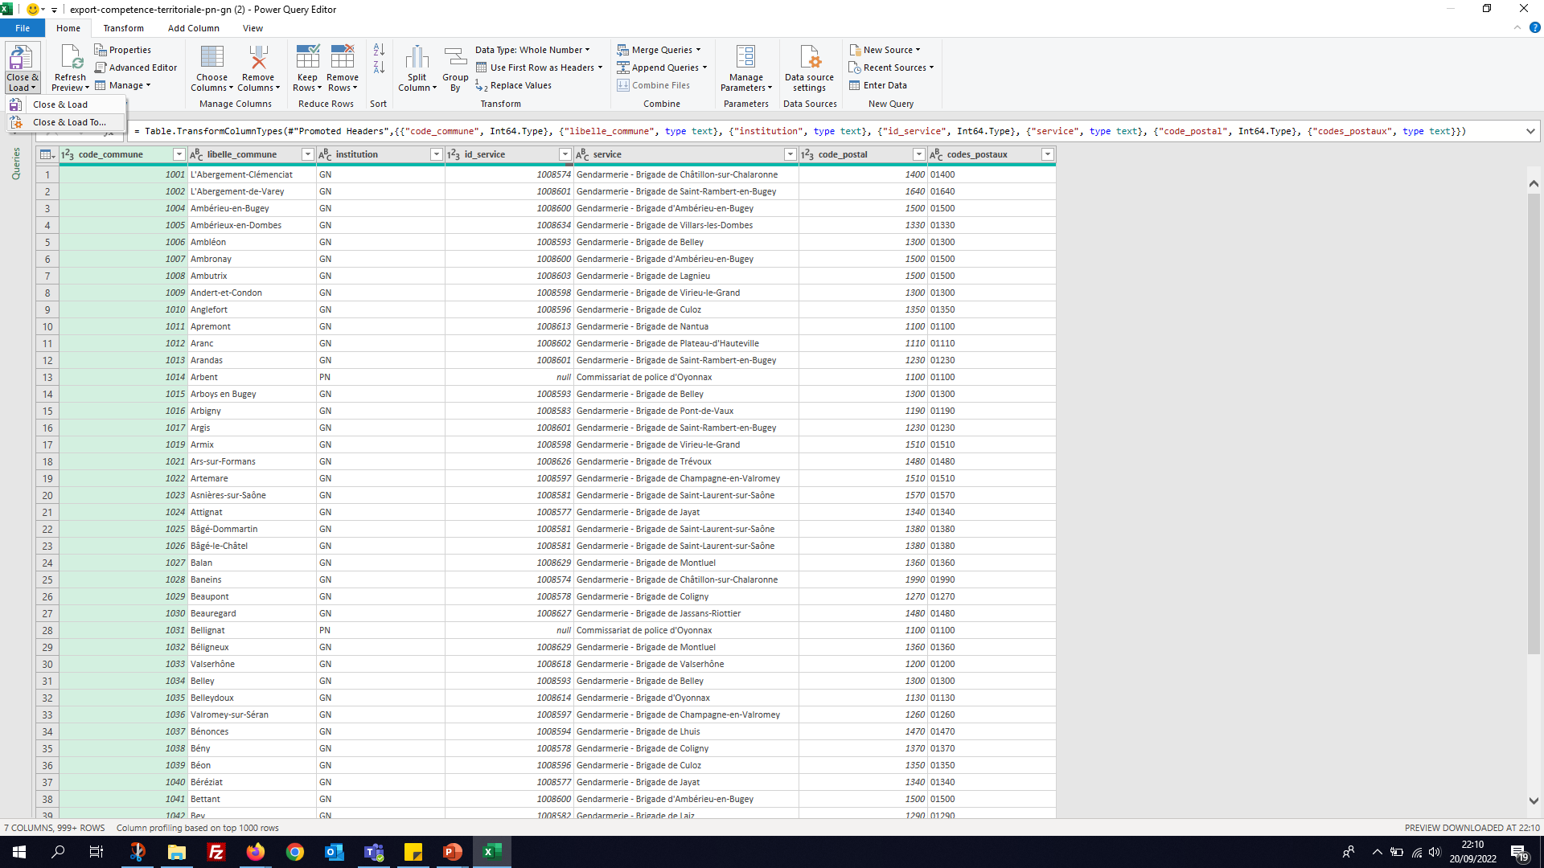
Importing Data in Excel
Importing CSV file – Part 5
Click the dropdown arrow below the Close & Load button and select Close & Load To.
Select that you would like to view this data as a table in the existing worksheet. The cell you selected will be listed.
Click the OK button.

Slide 14
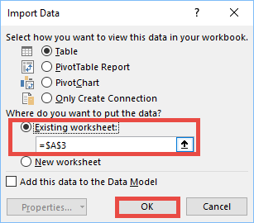
Importing Data in Excel
Importing CSV file – Part 6
In the Import Data dialog box, choose to put the data on an Existing sheet.
Check the cell location. Fix it if it’s not the right cell.
Click the OK button to perform the import.
Démo

Slide 15
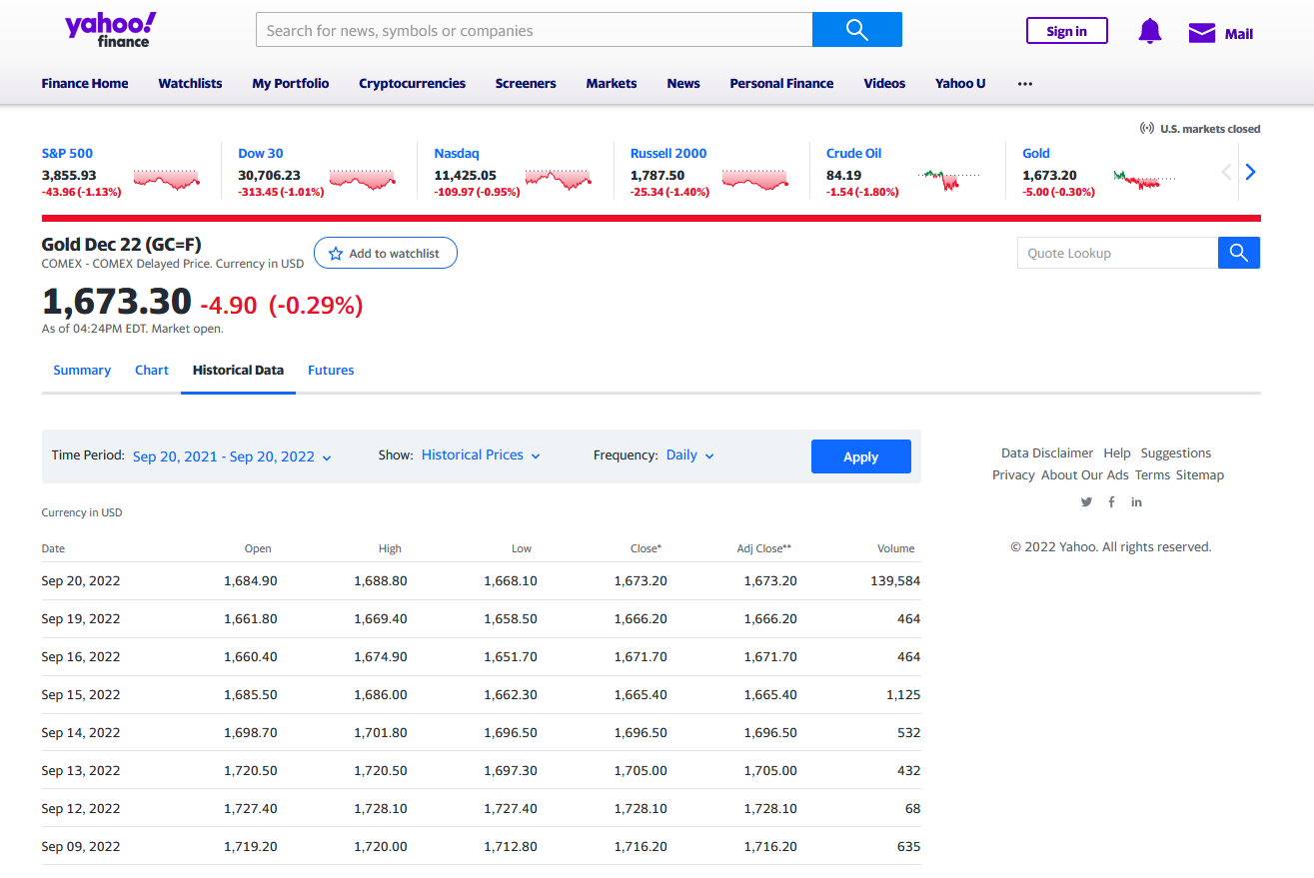
Importing Data in Excel
Importing Data from a Webpage – Part 1
Let’s assume that we need for our data mining project, we need to include the historical data of Gold Market in the analysis.

Slide 16
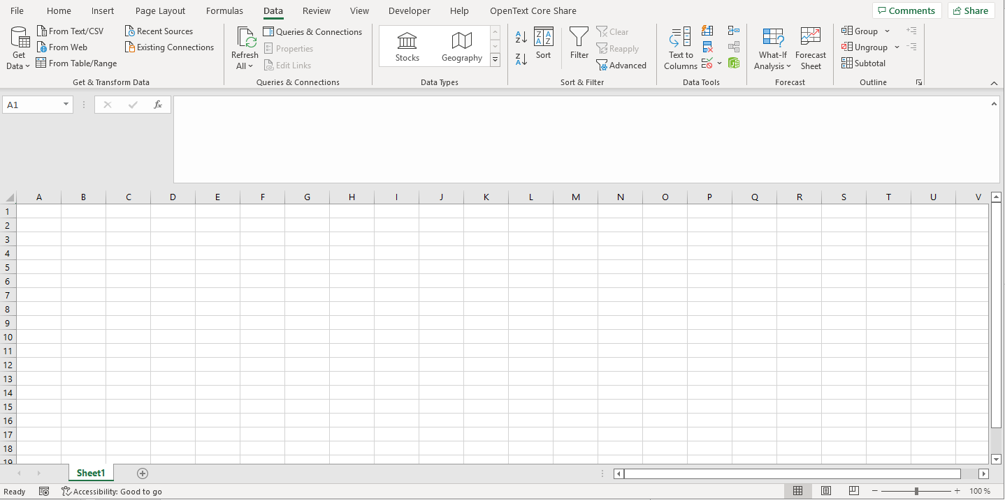
Importing Data in Excel
Importing Data from a Webpage – Part 2
Click the first cell on the worksheet to contain the imported data
Click the From Web button to display the From Web dialog box

Slide 17

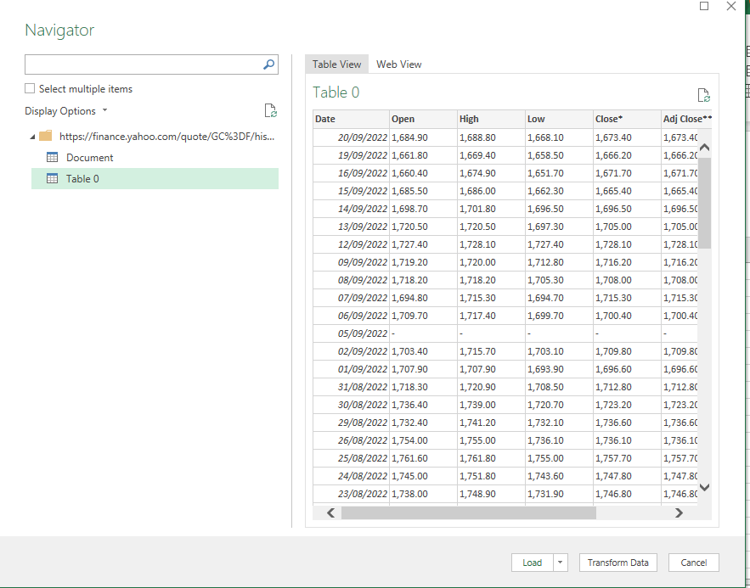
Importing Data in Excel
Importing Data from a Webpage – Part 3
Type the Web page address in the URL box
Click OK to display the Navigator dialog box
Click the table name
Click the Transform Data button to display the Power Query Editor window

Slide 18
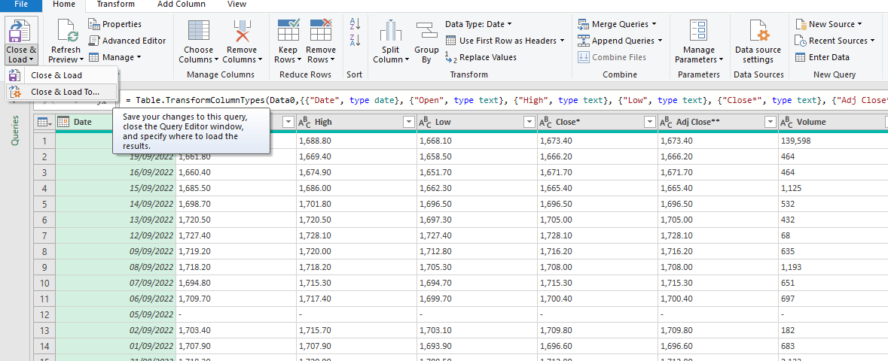
Importing Data in Excel
Importing Data from a Webpage – Part 4
Make desired selections
Click the Close & Load arrow and then click the Close & Load To command to close the Power Query Editor Window
When Excel displays the Import Data dialog box, click the Existing worksheet option button.
Click OK to import the data
Démo

Slide 19
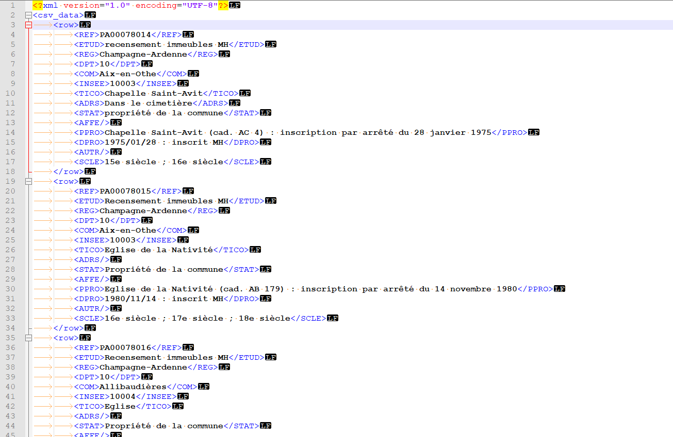
Importing Data in Excel
Importing Data from XML – Part 1
XML (Extensible Markup Language) is a markup language like HTML, but without predefined tags to use.
It is a powerful way to store data in a format that can be stored, searched, and shared.

Slide 20
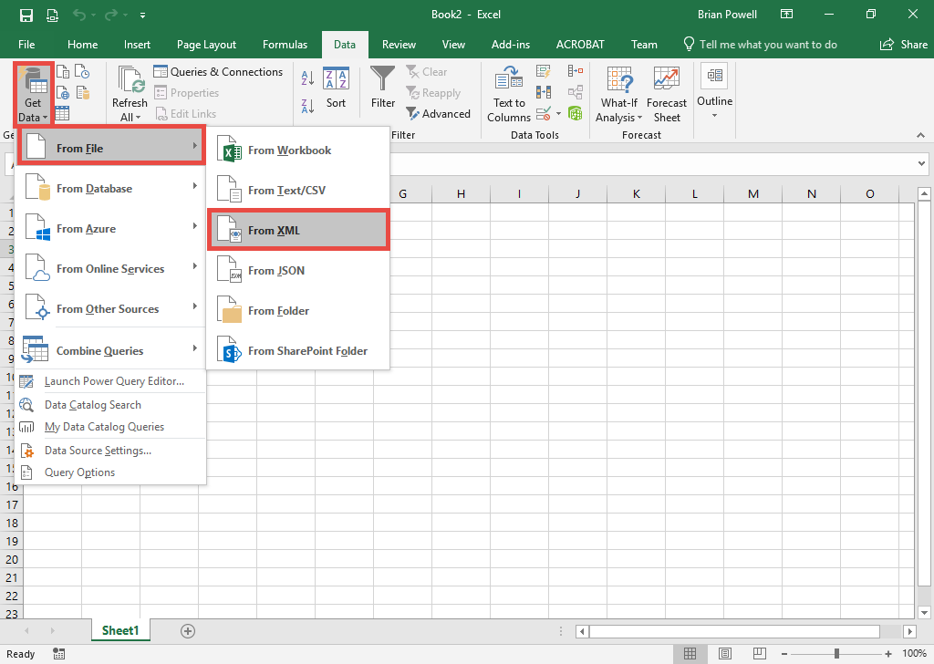
Importing Data in Excel
Importing Data from XML – Part 2
Click the cell where you want to import the XML file.
Go to the Data ribbon.
Click the Get Data button, select From File and then From XML.
Select the XML file to import.
Click the Import button.

Slide 21
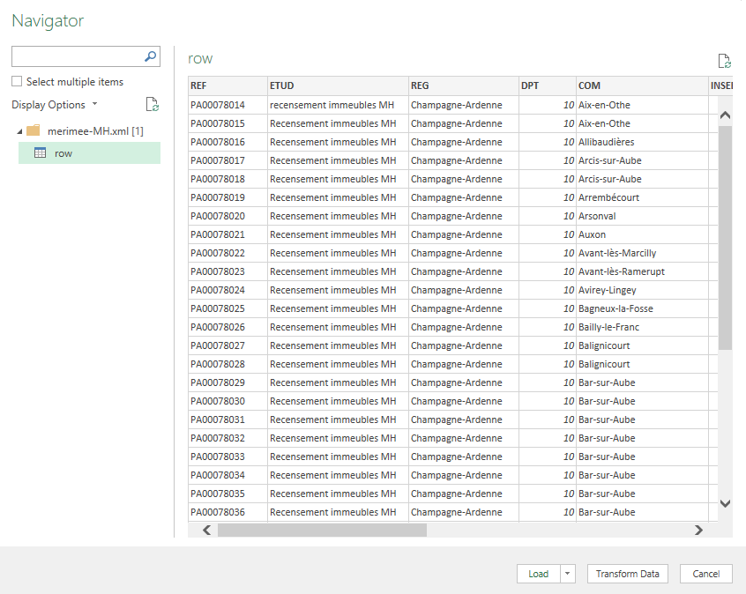
Importing Data in Excel
Importing Data from XML – Part 3
On the left pane of the Navigator dialog box, select the table you wish to import.
Click the Transform Data button.

Slide 22
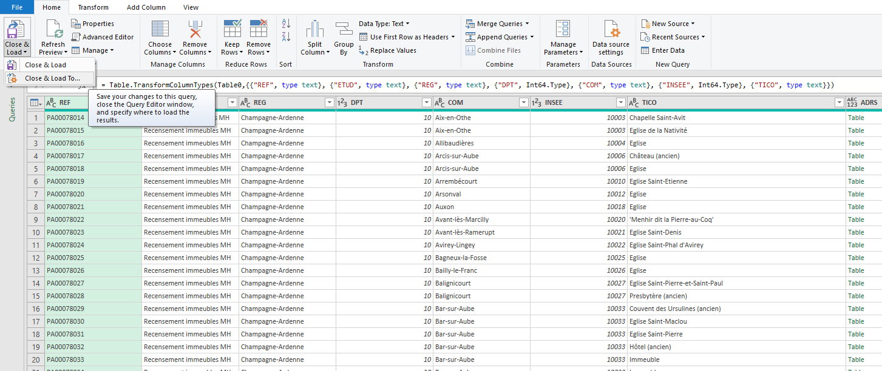
Importing Data in Excel
Importing Data from XML – Part 4
Click the dropdown arrow below the Close & Load button and select Close & Load To.
Select that you would like to view this data as a table in the existing worksheet. The cell you selected will be listed.
Click the OK button.
Démo

Slide 23
Data Tables
What is a Data Table ?
A range of data that is treated as a distinct object in a worksheet ➔ makes it easier to identify, manage, and analyze the related data.
In addition, the entire table is formatted using a single table style, a preset style that speciﬁes the formatting for an entire table.
Data tables can include optional elements such as :
a header row that contains titles for the different columns in the table
a total row that contains formulas summarizing the values in the table’s data.
You can create more than one Data table in a worksheet.

Slide 24
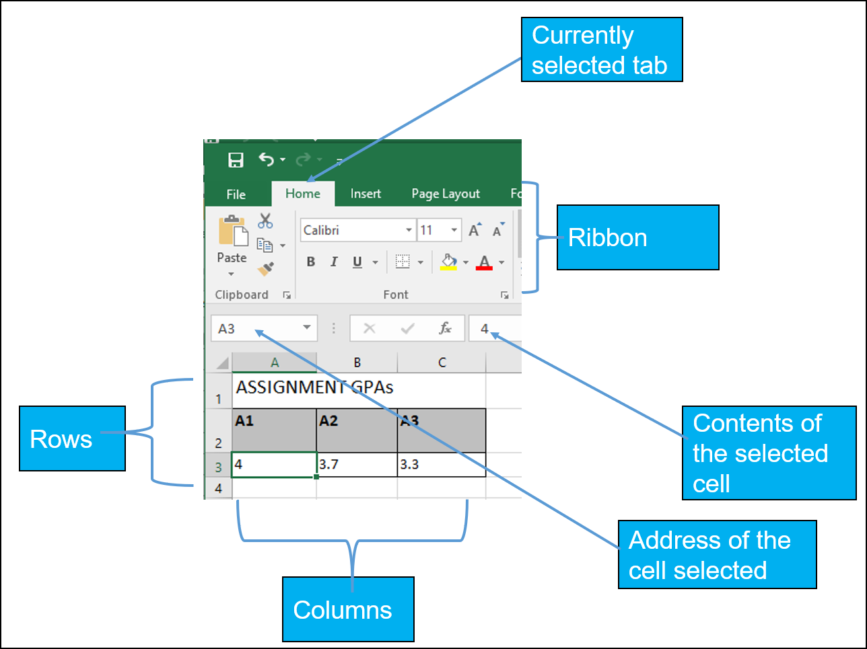
Data Tables
Basics

Slide 25
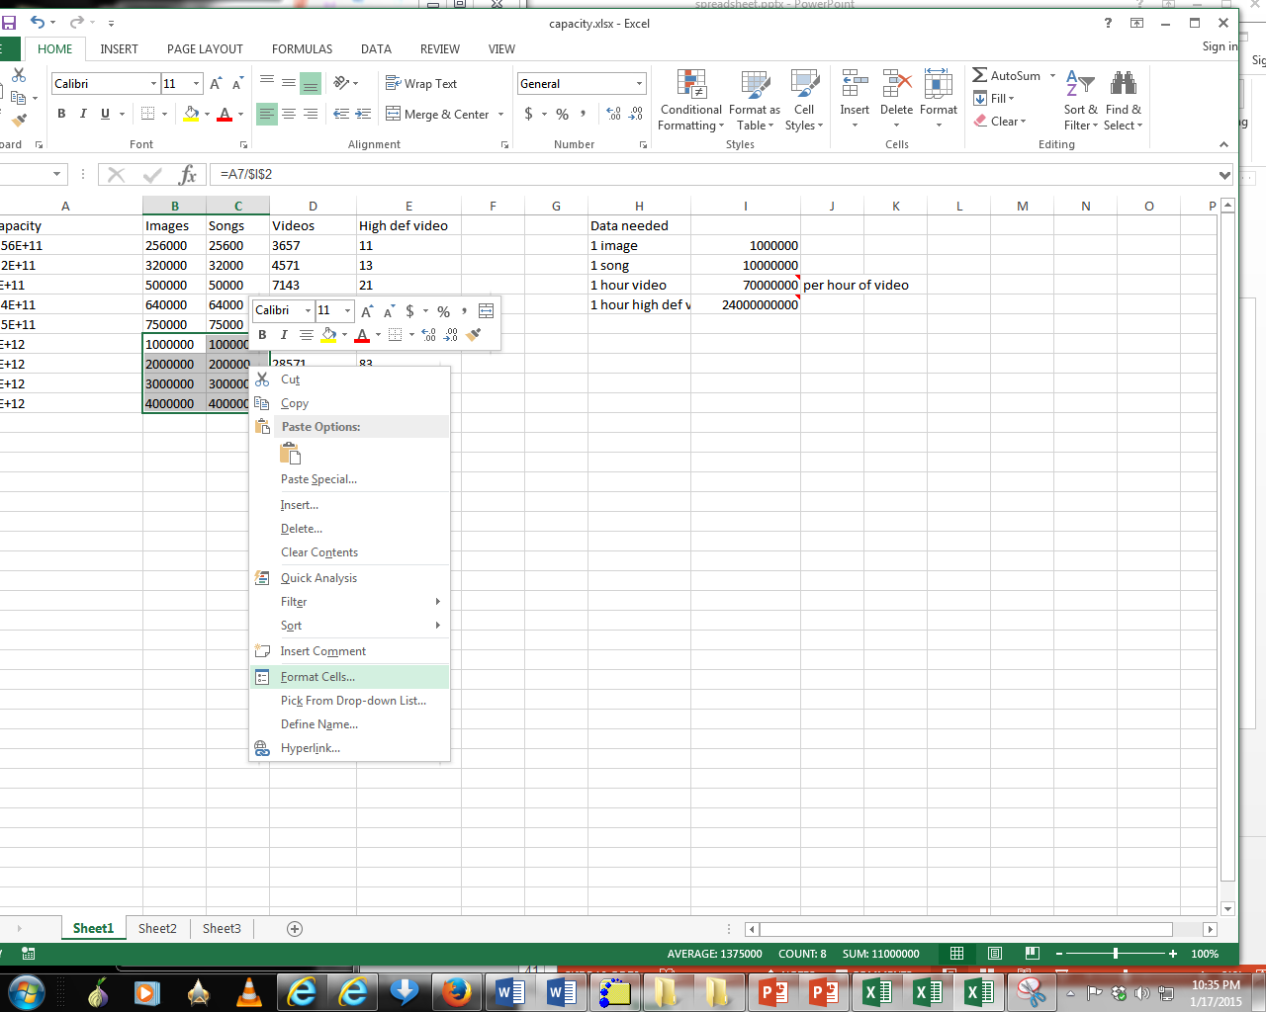
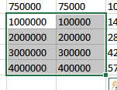
Data Tables
Data Format – Part 1
Excel provides the ability to format data in various locations of the ribbon.
You also can access these functions in the context of a cell or cells in the Data table.
Select a cell or cells for which you wish to apply similar formatting effects.
Right click and select Format Cells

Slide 26
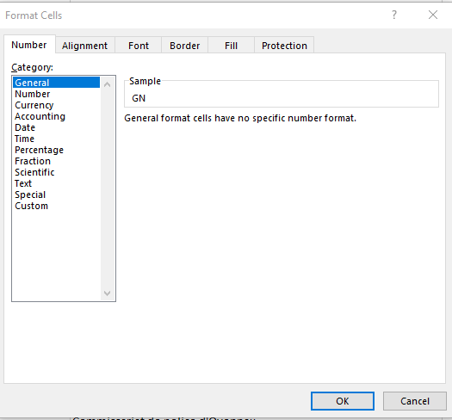
Data Tables
Data Format – Part 2
Choices Of Cell Data:
General: No special format
Number:
Separator (1 comma for 3 digits)
Several options for displaying negative numbers
Currency:
Currency sign appears
Several options for displaying negative numbers
Columns aligns decimal points
Accounting:
Like currency but no special options for displaying negative values
Date, Time:
Both allow the display to appear in different formats
Percentage: E.g., 100%
Fraction: e.g., when 0.75 is typed in it displays as 3/4

Slide 27
Data Tables
Data Format – Part 3
Scientific: 1.23E+06
Decimal point shifting = Exponent
Text:
Treats everything (even numbers) as text
Cell data is displayed exactly as entered.
Special:
Country specific information e.g., ZIP code
Custom:
You can create your own formats e.g., ID number = A22-B (alpha, two digits, dash, alpha)

Slide 28
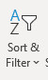
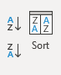
Data Tables
Data Sorting – Part 1
You can sort data using:
Home Tab
Data Tab commands
Right click and from the shortcut menu use the sort item and the menu,

Slide 29
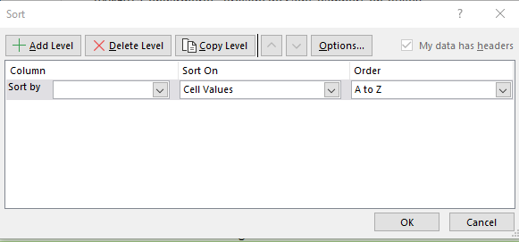
Data Tables
Data Sorting – Part 2
With a data table you may click in a cell and sort your column in various ways,
Numbers – Smallest to Largest or Largest to Smallest,
Dates – Oldest to Newest or Newest to Oldest,
Text – A to Z or Z to A,
Use the Custom Sort command to sort by more than one column,
Excel worksheets that are not in a data table arrangement require you to select the area you wish to sort and use the Custom Sort command to sort by the column(s) you wish.

Slide 30
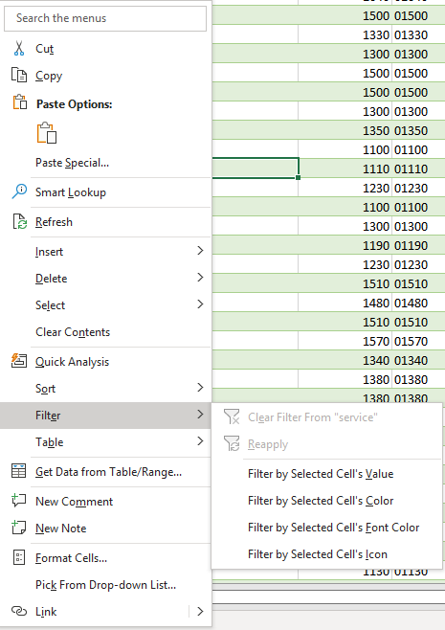
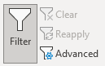
Data Tables
Data Filtering – Part 1
You can filter data using:
Home Tab
Data Tab commands
Right click and from the shortcut menu use the filter item and the menu,

Slide 31
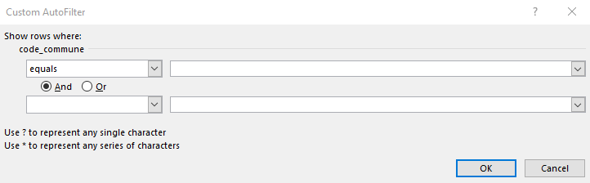
Data Tables
Data Filtering – Part 2
Small filtering arrows appear in your field names/column headers from which you may choose specific text, date, or numbers,
The filtering menu allows you to customize your filter for Number Filters, Date Filters, and Text Filter fields,
Numbers - Use between for number ranges, greater than, less than, and Top 10 criteria for numbers,
Dates - Use relative dates (Next Week, Last Year) or between for ranges,
Text - Use contains for character within a text, begins with, ends with, and so on,
The Custom Filter menu allows you to perform multiple criteria for your data.

Slide 32
Numbers and Formulas
Not all Numbers in Excel are true numbers, such a Security Social Number, Phone Number..
Here are the three criteria for a number in Excel:
No leading zeroes,
No special format (-, ?, space, :,) Number formats are monetary ($1,000), decimal (98.6), percent (110%), exponents 1028 etc.,
Used in calculations.
Formulas and Functions Syntax
Begin with equal sign = (for old timers the +),
Colon : ➔ A range of cells =SUM(B5:B55),
Comma , ➔ Non-Contiguous cells =AVERAGE(B6,D10,E55) and function delimiter =PMT(D5,D6,D7),
Must have parenthesis () =TODAY(),
Absolute and Mixed References $ ➔ ($A$1) or B$5,
Reference and Worksheet/Workbook linkage ! ➔ =SUM(January:December!B5) or =January!D100.

Slide 33
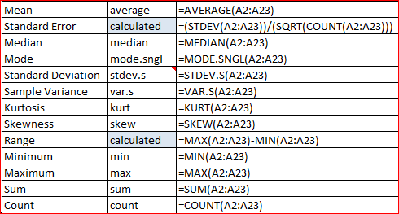
First Statististical Analysis
SUM – Adds or totals numbers in a column, row, or cells,
AVERAGE – Averages numbers in a column, row, or cells,
COUNT – Counts numbers in a column, row, or cells,
COUNTA – Counts nonblank/empty cells in a column, row, or cells regardless of text, number, or date data types,
MEDIAN – returns the middle value of a {sorted} list of supplied values
If an odd # of values in the list, then middle number
If an even # of values in the list, then the average of the two middle numbers
MODE.SNGL – returns the most frequently occurring value of a list of supplied numbers
What if there’s a tie? ➔ first one listed (lowest if sorted)
STDEV.S – returns the standard deviation of a supplied set of values (which represent a sample of a population)
A measure of how spread out the numbers are (square root of the variance)
VAR.S – returns the variance of a supplied set of values (which represent a sample of a population)
The average of the squared differences from the mean (average)
Notes:
Variance = mesure de la dispersion des valeurs d'un échantillon

Slide 34
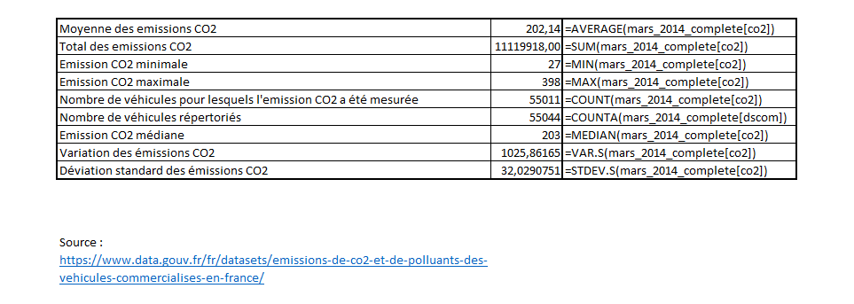
First Statististical Analysis
Example
Démo

Slide 35
Intermediate Statististical Analysis
SUMIFS – Adds or totals numbers in a column, row, or cells, that meet multiple conditions
AVERAGEIFS – Averages numbers in a column, row, or cells, that meet a multiple conditions
COUNTIF – Counts numbers in a column, row, or cells, that meet a single condition
IF – Returns TRUE if logical condition is met
AND – Return TRUE if all logical conditions are true
OR– Returns TRUE if one or more conditions is true

Slide 36
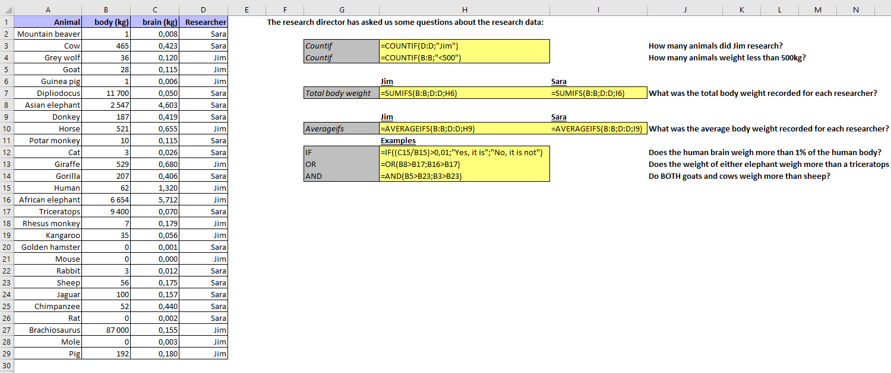
Intermediate Statististical Analysis
Example : AnimalsIntFunctions.xlsx
Démo

Slide 37
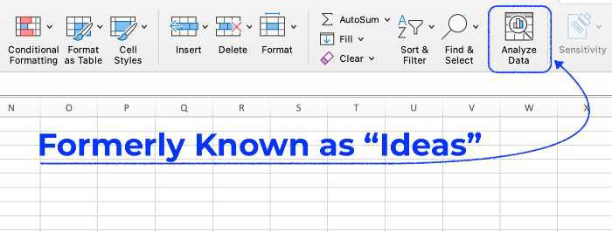
Data Exploration
What is Data Exploration?
Data exploration refers to the initial step in data analysis in which data analysts use data visualization and statistical techniques to describe dataset characterizations, such as size, quantity, and accuracy, in order to better understand the nature of the data.
Analyze Data Feature in Excel
Excel’s Analyze Data function is a powerful and easy-to-use tool for exploring data or data analytics. It can quickly identify relationships between variables and produce helpful visualizations.

Slide 38
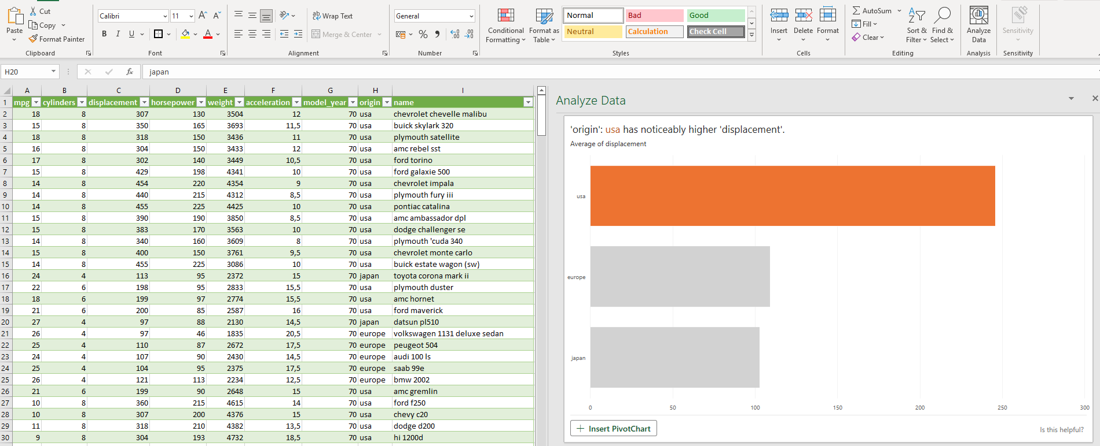
Data Exploration
Example 1 : Automobile Data (mpg.csv)
Démo

Slide 39
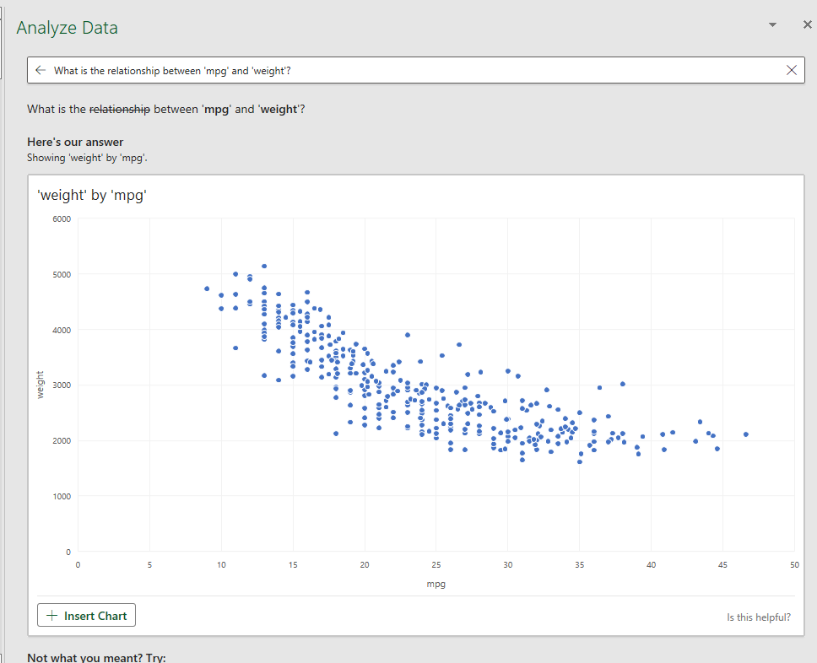
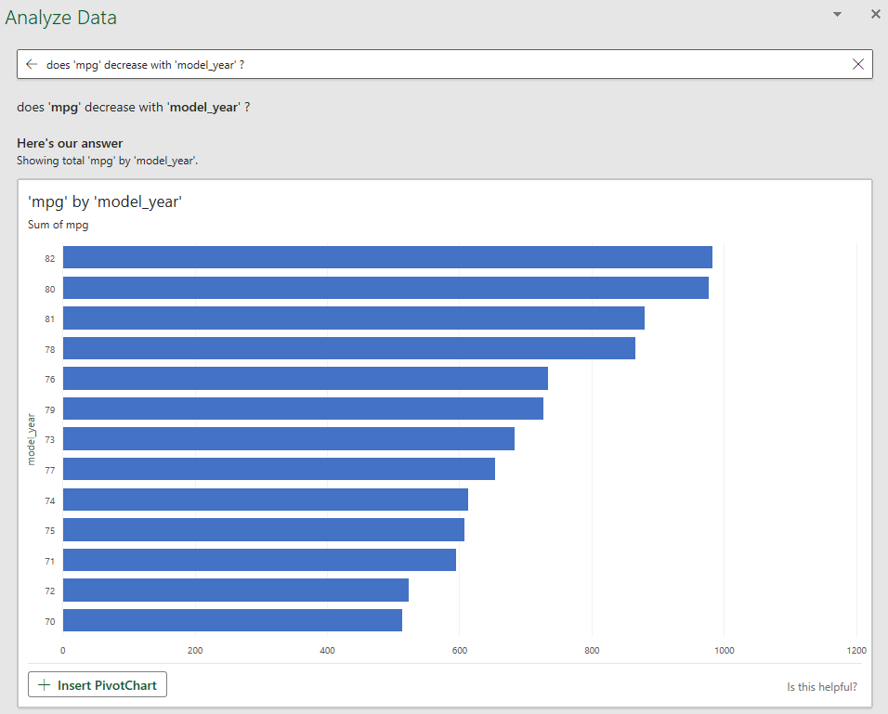
Data Exploration
Example 1 : Automobile Data (mpg.csv)

Slide 40
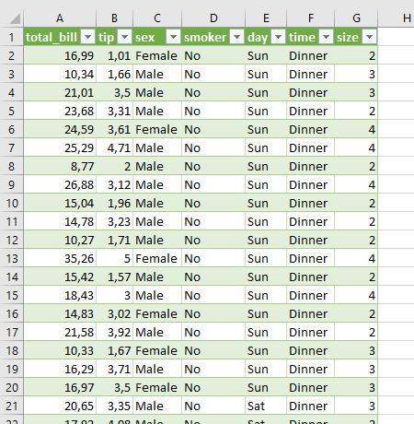
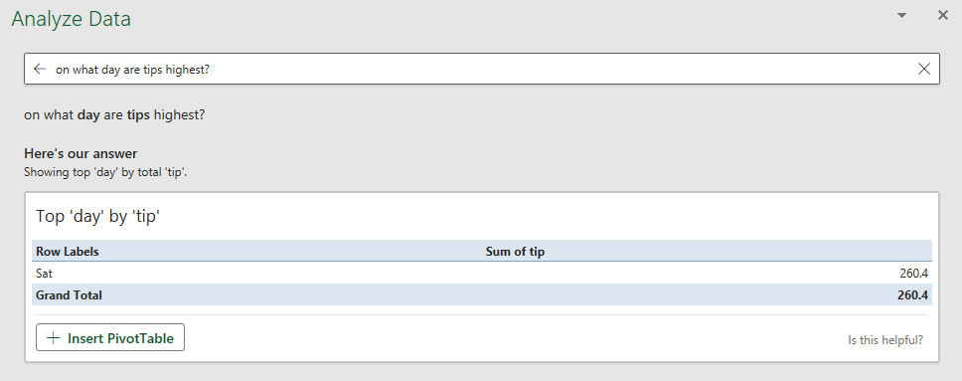
Data Exploration
Example 2 : Tips (tips.csv)
Data Source : https://github.com/mwaskom/seaborn-data

Slide 41
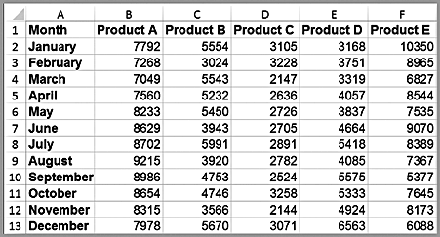
Data Visualization
What is Data Visualization ?
The process of displaying data (often in large quantities) in a meaningful fashion to provide insights that will support better decisions.
Data visualization improves decision-making, provides managers with better analysis capabilities that improves collaboration and information sharing.
Tabular vs. Visual Data Analysis
Tabular data can be used to determine exactly how many units of a certain product were sold in a particular month, or to compare one month to another.
For example, we see that sales of product A dropped in February, specifically by 6.7% (computed as 1 – B3/B2). Beyond such calculations, however, it is difficult to draw big picture conclusions

Slide 42
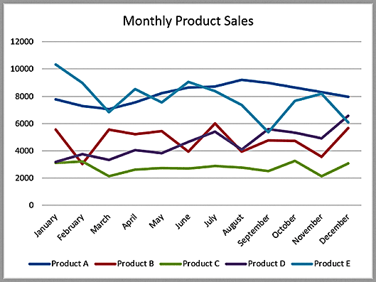
Data Visualization
Tabular vs. Visual Data Analysis
A Visual Chart provides the means to :
Easily compare overall sales of different products (Product C sells the least, for example);
Identify trends (sales of Product D are increasing), other patterns (sales of Product C is relatively stable while sales of Product B fluctuates more over time), and exceptions (Product E’s sales fell considerably in September).

Slide 43
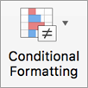
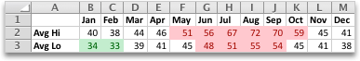
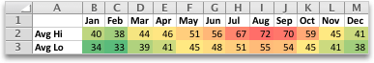
Data Visualization
Conditional Formatting
Conditional formatting makes it easy to highlight certain values or make cells easy to identify. This changes the appearance of a cell range based on a condition (or criteria). You can use conditional formatting to highlight cells that contain values which meet a certain condition. Or you can format a whole cell range and vary the exact format as the value of each cell varies.
Temperature information with conditional formatting applied that shows top 10% and bottom 10% values
Temperature information with 3-color scale conditional formatting applied
➔ Usefull tool to highlight Patterns and Trends

Slide 44
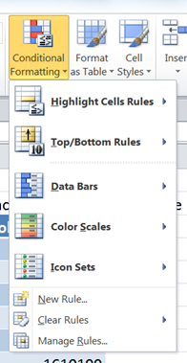
Data Visualization
Conditional Formatting
Excel has four conditional formats:
Highlight Cells Rules - Apply formatting to cells that satisfy a specific condition
Top/Bottom Rules - Apply formatting to cells that satisfy a statistical condition in relation to other cells in the range
Data Bars / Color Scales / Icon Sets - Apply formatting to all cells in the range, depending on their value in relation to one another;
New rule – Apply a custom rule
Clear rules – Removes all the rules that have been applied to the worksheet.
Manage Rules – View or edit the conditions that have been set

Slide 45
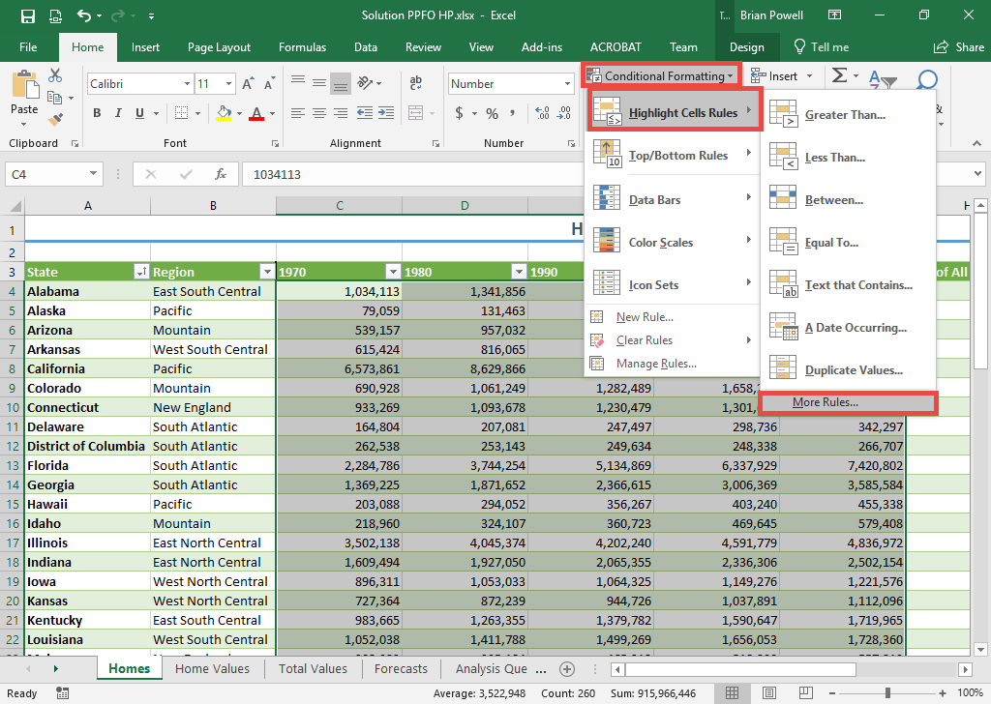
Data Visualization
Conditional Formatting
Highlight Cells Rules
Select the range of cells where you wish to apply conditional formatting.
Go to the Home ribbon.
In the Styles section, click Conditional Formatting
Select Highlight Cells Rules and then select More Rules.

Slide 46
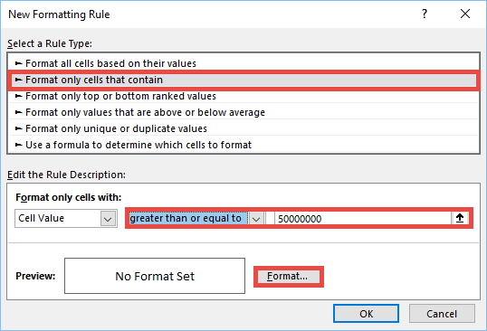
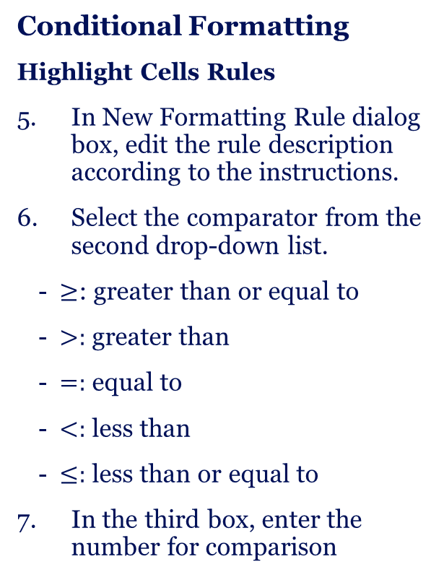
Data Visualization
Conditional Formatting
Highlight Cells Rules
In New Formatting Rule dialog box, edit the rule description according to the instructions.
Select the comparator from the second drop-down list.
$≥$: greater than or equal to
$>:$ greater than
$=:$ equal to
$<:$ less than
$≤:$ less than or equal to
In the third box, enter the number for comparison

Slide 47
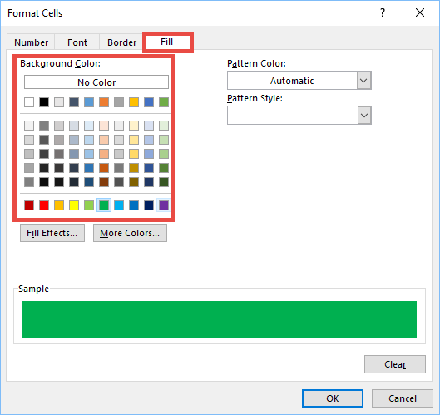
Data Visualization
Conditional Formatting
Highlight Cells Rules
Change the cell fill color:
Click Format.
Go to the Fill tab.
Select the fill color as required

Slide 48
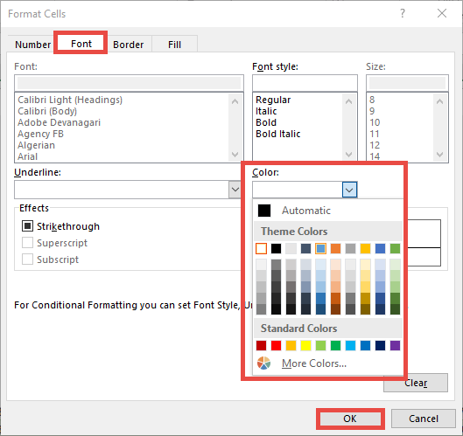
Data Visualization
Conditional Formatting
Highlight Cells Rules
Change the text color:
Go to the Font tab.
In the Color section, click the dropdown list to expand different color options.
Select the desired text color.
Click the OK button to return to the New Formatting Rule dialog box.
Click the OK button to apply the conditional formatting to the selected cells.

Slide 49
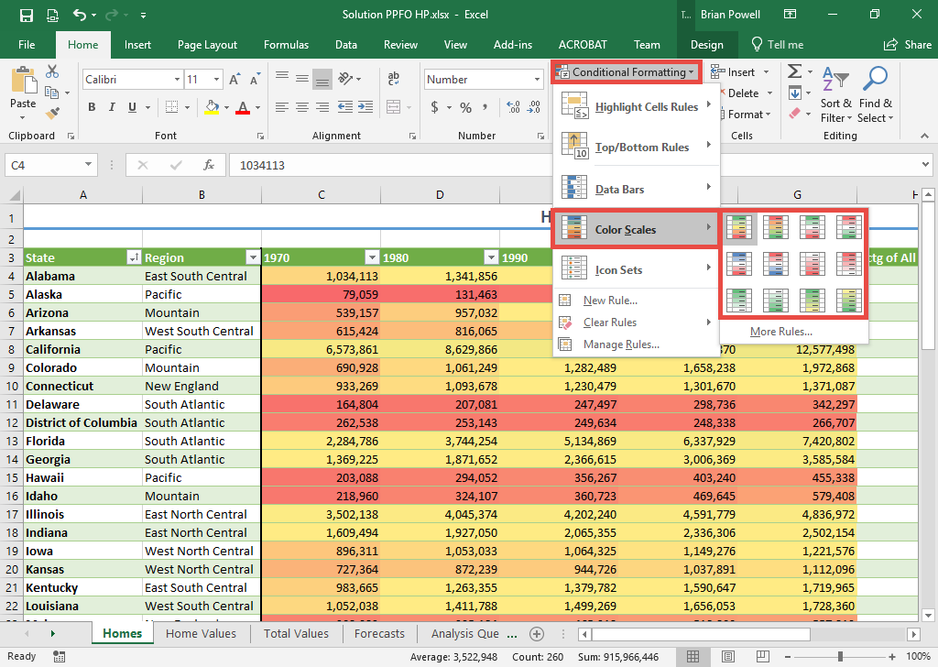
Data Visualization
Conditional Formatting
Color Scale
Color scales apply a range of colors to help easily differentiate high and low values.
Select the range of cells where you wish to apply color scale formatting.
Go to the Home ribbon.
In the Styles section, click Conditional Formatting.
Select Color Scales and then click the desired color scale.

Slide 50
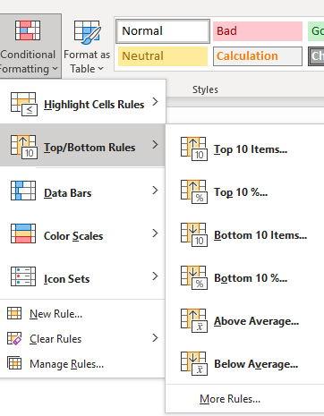
Data Visualization
Conditional Formatting
Top/Bottom Rules
Excel offers a variety of pre-set criteria for identifying and formatting cells that contain values within a numeric range. These include:
• Top/bottom items in a selected range
• Items in the top/bottom percentage of selected data
• Items which are above/below the average of the selected range
1. Select the cells to which you want to apply conditional formatting.
2. Select the Home tab.
3. From the Styles group, click on Conditional Formatting .
4. Select Top/Bottom Rules
5. From the submenu, select the criteria that you want to use: Top 10 Items..., Top 10%..., Above Average..., etc.

Slide 51
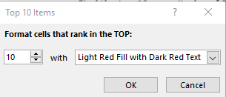
Data Visualization
Conditional Formatting
Top/Bottom Rules
6. Enter the value for the criteria, if necessary.
7. From the with drop-down list, select the formatting option that you want to apply to cells that meet the criteria.
8. Click OK.

Slide 52
Data Visualization
Conditional Formatting
Data Bars
Graphically displays the value of a cell in relation to the other selected cells, by drawing a bar at the left of the cell. The longer the bar, the higher the value in comparison to the rest.
Icon Sets
Graphically displays the value of a cell in relation to the other selected cells, by drawing symbols at the left of the cell. Different symbols represent the value of the cell in comparison to the rest.

Slide 53
Data Visualization
Conditional Formatting
Rules Manager
You can access the Conditional Formatting Rules Manager dialog box by selecting the cells that are controlled by the rules that you wish to change:
Select the Home tab
From the Styles group, click on Conditional Formatting
Select Manage Rules
In this dialog box you can specify whether you are changing the rules for the current selection of cells, the current worksheet, or another worksheet in the current workbook, before changing the order of precedence for rule evaluation and editing, adding and deleting rules as required. When you have made all the required changes, click on Apply then click on OK.

Slide 54
Data Visualization
Conditional Formatting
Rules Manager
Conditional Formatting Rules Precedence
When two or more conditional formatting rules apply to a range of cells, these rules are evaluated in order of precedence by how they are listed in the dialog box. A rule that is higher in the list has greater precedence than a rule that is lower in the list. By default, new rules are always added to the top of the list and therefore have a higher precedence; however, you can change the order of precedence by using the Move Up and Move Down arrow buttons in the dialog box.

Slide 55

Data Visualization
Conditional Formatting – Example : Quakes
Démo

Slide 56


Data Visualization
Creating Charts in Excel
Select the Insert tab.
Highlight the data.
Click on chart type, then subtype.
Use Chart Tools to customize.

Slide 57

Data Visualization
Column and Bar Charts
Excel distinguishes between vertical and horizontal bar charts, calling the former column charts and the latter bar charts.
A clustered column chart compares values across categories using vertical rectangles;
a stacked column chart displays the contribution of each value to the total by stacking the rectangles;
a 100% stacked column chart compares the percentage that each value contributes to a total.
Column and bar charts are useful for comparing categorical or ordinal data, for illustrating differences between sets of values, and for showing proportions or percentages of a whole.

Slide 58

Data Visualization
Line Charts
Line charts provide a useful means for displaying data over time.
You may plot multiple data series in line charts; however, they can be difficult to interpret if the magnitude of the data values differs greatly. In that case, it would be advisable to create separate charts for each data series.

Slide 59


Data Visualization
Pie Charts
A pie chart displays this by partitioning a circle into pie-shaped areas showing the relative proportion.
Data visualization professionals don't recommend using pie charts. In a pie chart, it is difficult to compare the relative sizes of areas; however, the bars in the column chart can easily be compared to determine relative ratios of the data.
If you do use pie charts, restrict them to small numbers of categories, always ensure that the numbers add to 100%, and use labels to display the group names and actual percentages. Avoid three-dimensional (3D) pie charts—especially those that are rotated—and keep them simple.

Slide 60

Data Visualization
Area Charts
An area chart combines the features of a pie chart with those of line charts.
Area charts present more information than pie or line charts alone but may clutter the observer’s mind with too many details if too many data series are used; thus, they should be used with care.

Slide 61

Data Visualization
Scatter Charts
Scatter charts show the relationship between two variables. To construct a scatter chart, we need observations that consist of pairs of variables.

Slide 62

Data Visualization
Bubble Charts
A bubble chart is a type of scatter chart in which the size of the data marker corresponds to the value of a third variable; consequently, it is a way to plot three variables in two dimensions.

Slide 63




Data Visualization
Démo
Miscellaneous Excel Charts
Stock chart
Surface chart
Doughnut chart
Radar chart

Slide 64

Data Visualization
Sparklines
A Box Plot in Excel is a graphical representation of the numerical values of a dataset. It shows a five-number summary of the data, which consists of the minimum, maximum, first quartile, second quartile (median), and third quartile.
Element | Meaning
Top of upper whisker | Maximum value of the sample
Top of box | 75th percentile of the sample
Line through the box | Median of the sample
Bottom of the box | 25th percentile of the sample
Bottom of the lower whisker | Minimum of the sample
× markers | Mean of the sample

Slide 65

Data Visualization
Démo
Sparklines
Sparklines are tiny charts that reside in a cell in Excel. These charts are used to show a trend over time or the variation in the dataset. You can use these sparklines to make your bland data look better by adding this layer of visual analysis.

Slide 66

Data Visualization
Démo
Control charts
The control chart is a graph used to study how a process changes over time. Data are plotted in time order. A control chart always has a central line for the average, an upper line for the upper control limit, and a lower line for the lower control limit. These lines are determined from historical data.

Slide 67

Data cleansing
Prepare Data before Analysis
Data cleaning is the process of identifying incomplete, inaccurate and/or irrelevant parts of a dataset and making corrections by modifying, replacing or deleting the ‘dirty’ data.
Data analysis should take place only after the data have been cleaned as it is important that the results of your analysis be built on accurate and strong data.
Data cleaning also has profound impacts on both the design process and analysis ➔ Analysis conducted on carefully cleaned data leads to clearer conclusions.

Slide 68

Data cleansing : Data Cleaning Techniques
Remove Duplicates – Part 1
One of the easiest ways of cleaning data in Excel is to remove duplicates. There is a considerable probability that it might unintentionally duplicate the data without the user's knowledge. In such scenarios, you can eliminate duplicate values.
The following dataset has two rows as duplicates.

Slide 69


Data cleansing : Data Cleaning Techniques
Remove Duplicates – Part 2
To eliminate the duplicate data, select the Data option in the toolbar, and in the Data Tools ribbon, select the Remove Duplicates option. This will provide you with the new dialogue box, as shown below.
Here, you need to select the columns you want to compare for duplication. Another critical step is to check in the headers' option as you included the column names in the data set. Excel will automatically scan it by default
We need to compare all columns, so check all the columns as shown below.

Slide 70

Data cleansing : Data Cleaning Techniques
Remove Duplicates – Part 3
Select Ok, and Excel performs the operations required and provides you with the data set after filtering out the duplicate data, as shown below.

Slide 71

Data cleansing : Data Cleaning Techniques
Data Parsing from Text to Column – Part 1
Sometimes, there is a possibility that one cell might have multiple data elements separated by a data delimiter like a comma. For example, consider that there is one column that stores address information.
The address column stores the street, city, postal code, and country. Commas separate all the data elements. You must now divide the street, city, postal code, and country, from the address columns into separate columns.
Excel's inbuilt functionality called Text to column can achieve this.
In this example, the car manufacturer and the car model name separated by space as the data delimiter. The tabular data is shown below.

Slide 72


Data cleansing : Data Cleaning Techniques
Data Parsing from Text to Column – Part 2
Select the data, click on the data option in the toolbar and then select Text to Column.
A new window will pop up on the screen, as shown below.
Select the delimiter option and click on Next. In the next window, you will see another dialogue box.

Slide 73


Data cleansing : Data Cleaning Techniques
Data Parsing from Text to Column – Part 4
In the new page dialogue box, you will see an option to select the type of delimiter your data has. In this case, you need to select the Space as a delimiter, as shown below.
In the last dialogue box, select the column data format as General, and the next step should be to click on the finish, as shown in the following image.

Slide 74

Data cleansing : Data Cleaning Techniques
Data Parsing from Text to Column – Part 5
The final resultant data will be available, as shown below.

Slide 75


Data cleansing : Data Cleaning Techniques
Change Case - Lower/Upper/Proper
You can manipulate the data in the Excel worksheet in terms of character cases if needed. To apply case changes, you can follow the following steps.
Select the table or columns that need the case to be changed, as shown below.
Select the cell next to the column and apply the formula as per the requirement

Slide 76


Data cleansing : Data Cleaning Techniques
Change Case - Lower/Upper/Proper
=UPPER(cell address) - for Upper case conversion
=LOWER(cell address) - for Lower case conversion
=PROPER(cell address) - for Sentence case conversion
Drag the cell can to the last row, as shown below.
The final data table will appear as shown below.

Slide 77


Data cleansing : Data Cleaning Techniques
TRIM Function
TRIM function is used to eliminate excess spaces and tab spaces in the Excel worksheet cells. The excessive blank spaces and tab spaces make the data hard to understand.
Using the TRIM function can eliminate these excessive blank spaces.
Select the data cells with excessive blank spaces and tab spaces.
Select a new cell adjacent to the first cell.
Apply the TRIM() function and drag the cell as shown below.

Slide 78

Data cleansing : Data Cleaning Techniques
Find and Replace
Find and Replace will help you fetch and replace data in the entire worksheet to help in organizing and cleaning data in Excel. Consider the employee data example.
Let’s try to fetch an employee with the name Joe and try to rename or replace his name with John, after changing his first name.

Slide 79


Data cleansing : Data Cleaning Techniques
Find and Replace
Find and replace option is present in the home ribbon in the editing group, as shown below.
Click on the option, and a new window will open, where you can enter the data to be fetched and enter the text you need to replace, as shown below.

Slide 80

Data cleansing : Data Cleaning Techniques
Find and Replace
Click on Replace all, and it will replace the text. The final dataset will be as shown below.
Démo

Slide 81

Data cleansing : Data Cleaning Techniques
Outliers
An outlier is a value that is significantly higher or lower than most of the values in your data. When using Excel to analyze data, outliers can skew the results. It will essentially drag your average in a positive or negative direction.
Removing these outliers will give you a better picture of your data.
You can use both visualizations and formulas to identify outliers in Excel.
How to identify outliers ?
Box Plots
In the image below you can see that several points exist outside of the box. The box is the central tendency of the data. It is clustered around a middle value. The upper bound line is the limit of the centralization of that data
You can easily identify outliers of your data by using Box and Whisker charts.
These are plots that show you how data is clustered around a central measure such
as the median (middle) value in the data.

Slide 82
Data cleansing : Data Cleaning Techniques
Quartiles : represent how the data is broken up into quarters.
The quartile is a dividing point which splits the data into quarters. There are 3 quartiles: Q1, Q2, and Q3.
Q1 is the lower quarter of your data where lesser values live
Q2 is the middle value
Q3 is the upper portion of the data
The range of values from Q1 to Q3 are called the inter-quartile range (IQR).
Outliers live outside the inner quartile range.
By statistical definition, they live 1.5 times below or above your inner quartile range.
Here is the formula you will be utilizing in Excel = QUARTILE(array, quart)
The two arguments in the functions are the data that you want to explore. in other words, when you have your data in Excel, it is mostly a list of values in a column. This list is your data array. The other part of the arguments is the quartile you want to define. For example, 1, 2, 3.

Slide 83

Data cleansing : Data Cleaning Techniques
Quartiles – Part 1
How to calculate the inner quartile range. This is calculated by subtracting Q1 from Q3. This can be named IQR
Next you will need to calculate the upper and lower limit of your range or your data. You can do this by following the formula below:
Lower range limit = Q1 – (1.5* IQR). Essentially this is 1.5 times the inner quartile range subtracting from your 1st quartile.
Higher range limit = Q3 + (1.5*IQR) This is 1.5 times IQR+ quartile 3.
Now if any of your data falls below or above these limits, it will be considered an outlier.
Démo

Slide 84
Data cleansing : Data Cleaning Techniques
How to deal with outliers ?
We have seen the methods that will help us find the outliers in our data set. But what to do once you know that there are outliers.
Here are a couple of methods that you can use to handle outliers so that your data analysis is correct.
Delete the Outliers
The easiest way to remove outliers from a data set is to simply delete them. This way it won’t skew your analysis.
It’s a more viable solution when you have large datasets and deleting a couple of outliers won’t impact the overall analysis. And of course, before deleting the data make sure you create a copy and delve into what’s causing these outliers.
Normalize the Outliers (Adjust the Value)
For all the outlier values, simply change them to a value that is slightly higher than the maximum value in the data set.
This made sure that we are not deleting the data but at the same time you we not letting it skew the data.

Slide 85

Data cleansing : Handling Missing Data
Traditional Approaches for handling Missing data
We now turn our attention to some of the methods used for handling missing data. We will start by looking at the data shown in this figure.
Here we see that 5 of the 12 data elements are missing.
We show the full data set without any missing data as well, keeping in mind that in practice we will almost never have the luxury of knowing what the missing data are really supposed to be.

Slide 86

Data cleansing : Handling Missing Data
Imputation using the mean
We can impute the value of any missing data based on the values of the non-missing data. A simple approach is to fill in the values of the missing science values with the value of the mean of the non-missing data, namely 35.4287 (cell G18).
The result is that the standard deviation of the science variable has decreased from 7.525 to 5.557, which is not surprising since the deviations for these last five data elements are 0. That we get biased values for the standard deviation is clearly not very desirable.

Slide 87

Data cleansing : Handling Missing Data
Imputation using regression
Another approach for filling in the missing data is to use the forecasted values of the missing data based on a regression model derived from the non-missing data.
This time we impute the values of the five missing cells by inserting the array formula =FORECAST(J13:J17,G6:G12,F6:F12) in the range K13:K17. Since this results in a perfect linear correlation between the math and science values for the last five data elements, it is not surprising that the correlation coefficient between math and science rises from .769 (cell F20) to .859 (cell J20). The standard deviation also falls.)
Note that the estimate for the correlation coefficient produced by this approach is quite close to that observed for the complete data (cell B20) since the correlation there is already quite high. The standard deviation is again lower than that for the complete model (cell C19).

Slide 88
Data cleansing : Handling Missing Data
Categorical data :
The popular methods to handle the missing values for categorical variables in the dataset are as follows:
Delete the observations: If there is a large number of observations in the dataset, where all the classes to be predicted are sufficiently represented in the training data, then try deleting the missing value observations, which would not bring significant change in your feed to your model.
Replace missing values with the most frequent value: You can always impute them based on Mode in the case of categorical variables, just make sure you don’t have highly skewed class distributions. NOTE: But in some cases, this strategy can make the data imbalanced wrt classes if there are a huge number of missing values present in our dataset.
Develop a model to predict missing values: One smart way of doing this could be training a classifier over your columns with missing values as a dependent variable against other features of your data set and trying to impute based on the newly trained classifier.

Slide 89


Pivot Table – Part1
A PivotTable is a powerful tool to calculate, summarize, and analyze data that lets you see comparisons, patterns, and trends in your data. PivotTables work a little bit differently depending on what platform you are using to run Excel.
1. Select the cells you want to create a PivotTable from.
2. Select Insert > PivotTable.
3. This will create a PivotTable based on an existing table or range.
4. Choose where you want the PivotTable report to be placed. Select New Worksheet to place the PivotTable in a new worksheet or Existing Worksheet and select where you want the new PivotTable to appear.

Slide 90


Pivot table – Part 2
1. To add a field to your PivotTable, select the field name checkbox in the PivotTables Fields pane.
2. To move a field from one area to another, drag the field to the target area.

Slide 91

Pivot table – Part 3
If you add new data to your PivotTable data source, any PivotTables that were built on that data source need to be refreshed. To refresh just one PivotTable you can right-click anywhere in the PivotTable range, then select Refresh. If you have multiple PivotTables, first select any cell in any PivotTable, then on the Ribbon go to PivotTable Analyze > click the arrow under the Refresh button and select Refresh All.

Slide 92


Pivot table – Part 4
Démo
Working with PivotTable data
1. Summarize Values By
By default, PivotTable fields that are placed in the Values area will be displayed as a SUM. If Excel interprets your data as text, it will be displayed as a COUNT. This is why it's so important to make sure you don't mix data types for value fields. You can change the default calculation by first clicking on the arrow to the right of the field name, then select the Value Field Settings option.
2. Next, change the calculation in the Summarize Values By section. Note that when you change the calculation method, Excel will automatically append it in the Custom Name section, like "Sum of FieldName", but you can change it. If you click the Number Format button, you can change the number format for the entire field.

Slide 93

PivotChart
PivotCharts provide graphical representations of the data in their associated PivotTables. PivotCharts are also interactive. When you create a PivotChart, the PivotChart Filter Pane appears. You can use this filter pane to sort and filter the PivotChart's underlying data.
1. Select a cell in your table.
2. Select Insert > PivotChart
3. Select where you want the PivotChart to appear.
4. Select OK.
5. Select the fields to display in the menu.

Slide 94


Slicers
Excel 2010 introduced Slicers — tools for drilling down to “slice” a PivotTable and display a subset of data.
To create a slicer for any of the columns in the database, click on the PivotTable and choose Insert Slicer from the Analyze tab in the PivotTable Tools ribbon.
Démo

Slide 95
Contingency Table
A contingency table, also known as a crosstab is used to show the relationship between two categorical variables.
In Excel, we can make a contingency table using the pivot table function.
They are best for summarizing the relationship between categorical variables.
A Contingency table is just like a frequency distribution table in which we can show two variables simultaneously.

Slide 96

Contingency Table
Creating a Contingency Table – Part 1
Suppose we have the following dataset that shows information for 20 different product orders, including the type of product purchased (TV, computer, or radio) along with the country (A, B, or C) that the product was purchased in:

Slide 97


Contingency Table
Creating a Contingency Table – Part 2
Click the Insert tab, then click PivotTable.
In the window that pops up, choose A1:C21 for the range of values. Then choose a location to place the pivot table in. We’ll choose cell E2 within the existing worksheet:

Slide 98


Contingency Table
Creating a Contingency Table – Part 3
Once you click OK, an empty contingency table will appear in cell E2.
In the window that appears on the right, drag Country into the box titled Rows, drag Product into the box titled Columns, and drag Order Number into the box titled Values:
Note: If Values first appears as Sum of Order Number simply click the dropdown arrow and select Value Field Settings. Then choose Count and click OK.

Slide 99

Contingency Table
Interpret the contingency table
Row Totals:
A total of 4 orders were made from country A.
A total of 8 orders were made from country B.
A total of 8 orders were made from country C.
Column Totals:
A total of 6 computers were purchased.
A total of 5 radios were purchased.
A total of 9 TV’s were purchased.
Individual Cells:
A total of 1 computer was purchased from country A.
A total of 3 computers were purchased from country B.
A total of 2 computers were purchased from country C.
A total of 0 radios were purchased from country A.
A total of 2 radios were purchased from country B.
A total of 3 radios were purchased from country C.
A total of 3 TV’s were purchased from country A.
A total of 3 TV’s were purchased from country B.
A total of 3 TV’s were purchased from country
Démo

Slide 100

Correlation vs Causation
A correlation between variables, does not automatically mean that the change in one variable is the cause of the change in the values of the other variable.
Causation indicates that one event is the result of the occurrence of the other event; i.e., there is a causal relationship between the two events.
Correlation | Causation
Relationship | Influence
Interrelation between variables | Cause and effect
Is symetric between two variables | One way relationship

Slide 101
How to detect Causation
In order to prove causation, we need a randomized experiment.
So, an experiment needs to have three types of variables: controlled, independent, and dependent:
A controlled variable is kept constant, so other variables that change in relation to each other can be measured in a static environment.
An experiment’s independent variable is the only one that can be changed.
Dependent variables are the results that are observed when changes are made to independent variables.
Good predictions are based on correlation
We don’t make better predictions by developing a better casual understanding. Instead, we need to know the precise limits of the techniques we use to make predictions and what each method can do for us.

Slide 102
Bivariate Analysis
The term bivariate analysis refers to the analysis of two variables.
The purpose of bivariate analysis is to understand the relationship between two variables.
There are three common ways to perform bivariate analysis:
Scatterplots
Correlation Coefficients
Simple Linear Regression

Slide 103

Bivariate Analysis
We will use the following dataset to illustrate how to perform each of these types of bivariate analysis in Excel.
Hours spent studying
Exam score received for 20 different students

Slide 104

Bivariate Analysis
Scatterplots
To create a scatterplot of hours vs. score, we can highlight cells A2:B21, then click the Insert tab along the top ribbon, then click Insert Scatter Chart within the Charts group:

Slide 105

Bivariate Analysis
Scatterplots
We can also modify the y-axis limits to gain a better view of the data points.
To do so, double click the y-axis. In the Format Axis panel that appears on the right side of the screen, click Axis Options and then change the Minimum and Maximum bounds to 60 and 100, respectively.
The y-axis will automatically update.
The x-axis shows the hours studied and the y-axis shows the exam score received.
From the plot we can see that there is a positive relationship between the two variables. As hours studied increases, exam score tends to increase as well.

Slide 106


Bivariate Analysis
Correlation Coefficients – Part 1
Correlation coefficient formulas are used to find how strong a relationship is between data. The formulas return a value between -1 and 1, where:
1 indicates a strong positive relationship.
-1 indicates a strong negative relationship.
Zero indicates no relationship at all.
A Pearson Correlation Coefficient is a way to quantify the linear relationship between two variables:

Slide 107

Bivariate Analysis
Correlation Coefficients– Part 2
We can use the following formula in Excel to calculate the correlation coefficient between hours studied and exam score:
The correlation coefficient turns out to be 0.891.
This value is close to 1, which indicates a strong positive correlation between hours studied and exam score received.
=CORREL(A2:A21, B2:B21)

Slide 108
Bivariate Analysis
Simple Linear Regression – Part 1
A simple linear regression is a linear equation describing the relationship between an explanatory variable X and an outcome variable Y, specifically with the assumption that the explanatory variable influences the outcome variable, and not vice-versa.
The mathematical equation for the general linear model using population parameters is:
Y = β0 + β1X + ε
Where :
Y and X represent the scores for individual on the criterion and predictor variable, respectively.
The parameters β0 and β1 are constants describing the functional relationship in the population.
The value of β1 identifies the change along the Y scale expected for every unit changed in fixed values of X (represents the slope or degree of steepness).
The values of β0 identifies an adjustment constant due to scale differences in measuring X and Y (the intercept or the place on the Y axis through which the straight-line passes. It is the value of Y when X = 0).
ε represents an error component for each individual. The portion of Y score that cannot be accounted for by its systematic relationship with values of X

Slide 109


Bivariate Analysis
Simple Linear Regression – Part 2
Linear regression is method to predict dependent variable Y based on values of independent variable X: it is used to predict continuous variables.

Slide 110

Bivariate Analysis
Simple Linear Regression – Part 2
Simple linear regression is a statistical method we can use to quantify the relationship between two variables.
To fit a simple linear regression model in Excel, click the Data tab along the top ribbon, then click the Data Analysis option in the Analyze group. In the new panel that appears, click Regression and then click OK.
Note: If you don’t see the Data Analysis option, you need to first load the Excel Analysis ToolPak.
In the panel that appears, enter the following information and then click OK.

Slide 111

Bivariate Analysis
Simple Linear Regression – Part 3
Once you click OK, the results of the regression model will appear:
The fitted regression equation turns out to be:
Exam Score = 69.0734 + 3.8471*(hours studied)
This tells us that each additional hour studied is associated with an average increase of 3.8471 in exam score.
We can also use the regression equation to estimate the score that a student will receive based on their total hours studied.
For example, a student who studies for 3 hours is estimated to receive a score of 81.6147:
Exam Score = 69.0734 + 3.8471*(hours studied)
Exam Score = 69.0734 + 3.8471*(3)
Exam Score = 81.6147

Slide 112
Bivariate Analysis
Regression metrics :
Multiple R. This is the correlation coefficient. It tells you how strong the linear relationship is. For example, a value of 1 means a perfect positive relationship and a value of zero means no relationship at all. It is the square root of r squared (see #2).
R squared. This is r2, the Coefficient of Determination. It tells you how many points fall on the regression line. for example, 80% means that 80% of the variation of y-values around the mean are explained by the x-values. In other words, 80% of the values fit the model.
Adjusted R square. The adjusted R-square adjusts for the number of terms in a model. You’ll want to use this instead of #2 if you have more than one x variable.
Standard Error of the regression: An estimate of the standard deviation of the error μ. This is not the same as the standard error in descriptive statistics! The standard error of the regression is the precision that the regression coefficient is measured; if the coefficient is large compared to the standard error, then the coefficient is probably different from
Démo

Slide 113


Logistic regression
Classification
In classification problems data are classified into two or more classes
A classification problem with two classes is called binary, more than two classes is called multi-class classification.
Regression
A regression problem is a problem that requires the prediction of a continuous values.
A regression problem with multiple input variables is called a multivariate regression problem.

Slide 114





Nonlinear regression
A method where we model data by nonlinear function of the independent and the dependent variable
Such models can be Quadratic, exponential or Logistic
Logistic regressions
Multi-category
Binary

Slide 115

Logistic regression
Logistic regressions a method used to predict dependent variable Y given an independent variable, where the independent variable is categorical.
Primarily logistic regression predicts the probability of an event occurring.
Dependent variable (Y): binary response variable holding value like 1 or 0, yes or no, or multi-categories : A, B, C
Independent variable (X): Predictor variable used to predict the response variable

Slide 116
From linear to logit regression
The "logit" model solves these problem
ln[p/(1-p)] = α + βX +ε
p is the probability that the event Y occurs, p(Y=1)
p/(1-p) is called "odds ratio"
ln[p/(1-p)] is the log odds ratio, or "logit"
The logistic distribution constrains the estimated probabilities to lie between 0 and 1.
So, a logistic regression can be seen as a proxy to a linear regression.
Démo

Slide 117
Quantitative Vs Qualitatives Data
Definitions – Part 1
Qualitative variables contain values that express a quality, a state, i.e., a condition, a unique and exclusive status such as sex, color or socio-professional category.
The arithmetic operations that can be performed on this type of variable are relatively reduced and are limited to the counting of the numbers per modality (absolute frequencies) and the calculation of percentages (relative frequencies) and the mode.
Qualitative variable, whether nominal or ordinal, is always discrete in nature, unlike a quantitative variable which can be either discrete or continuous in nature.
Some treatments and analyses of qualitative data and variables require that they present a "pseudo quantitative" form instead of their "nominal" form. This is particularly the case when qualitative variables are used in a multivariate treatment or simply when one wishes to make them manipulable and compatible with statistical software.
Quantitative data | Qualitative Data
Countable and measurable | Not countable/measurable
”How many?” “How much?” “How often?” | ”Why” ”How”

Slide 118

Quantitative Vs Qualitatives Data
Definitions – Part 2
Categorical data: Discrete and ordinal, variables with a certain hierarchy.
Example:
5 = Very good
4 = Good
3 = Average
2 = Bad
1 = Very poor
Dummy variable
Can only take 2 values : 0 or 1
Indicate the presence or absence of some categorical effect
Used for non hierarchal data
Example: Gender
Male
Female
It should be noted that the numbers assigned to the qualitative modalities for the purpose of their transformation have no meaning and cannot be the object of arithmetical operations such as the calculation of a sum or an average. They are "numbers" that do not alter the fundamental properties of the categorical variables, whether nominal or ordinal.

Slide 119
Quantitative Vs Qualitatives Data
Transforming quantitative variables into qualitative variables
Quantitative data or variables contain numerical values referring to a recognized unit of measurement. For this reason, they are sometimes referred to as metric variables. Height, weight, area, distance, income, age, turnover or population (in the sense of number of inhabitants) are quantitative variables.
All simple and complex arithmetic operations are applicable to quantitative variables, from enumeration (absolute frequencies) and other percentage calculations (relative frequencies) through the mean, median and standard deviation to numerical modeling.
The transformation of a quantitative variable into a qualitative variable, is also possible and even desirable in certain cases of figures even if it remains more delicate and imposes the respect of much stricter rules.
Most of the time, the transformation of a quantitative variable into a qualitative variable involves the constitution of classes from the observed distribution.

Slide 120
Quantitatives to qualitatives
Discretization – part 1
This operation is called discretization since, whatever the nature of the quantitative data upstream (interval or ratio, discrete or continuous), it inevitably results in the production of a discrete ordinal qualitative variable.
Warning: It is therefore important to bear in mind that this transformation leads to a loss of information and also to a reduction in the capacity to analyze and process the data since certain parameters can no longer be calculated precisely from a discrete distribution (mean, standard deviation, etc.).
Methods
There are several complex methods for the discretization of a distribution of values, best method will always be the knowledge that we have of the studied phenomenon.
There are therefore two groups of discretization methods:
Empirical methods: based on experience and knowledge of the phenomenon studied, they also use the shape of the distribution to detect natural breaks and thus delimit the boundaries of the classes to be created. This method, partly visual, requires a good knowledge of the phenomenon to be treated.

Slide 121
Quantitatives to qualitatives
Discretization – part 2
Default methods: do not require either a thorough knowledge of the phenomenon or a study of the distribution. Their simplicity is equal to the approximations they generate, and they tend, in fact, to smooth the studied phenomenon. Their principle is simple: considering either the total size of the population studied or the total amplitude of the distribution of the variable studied, these methods propose, as soon as a desired number of classes is defined :
either a discretization into classes of Equal Amplitude,
or a discretization into classes of Equal Size.
How to determine the number of classes ?
Two methods are proposed to create a meaningful breakdown:
They consider the total number of people in the distribution.
For Brooks-Carruthers, the number of classes K1 must be :
K1 < 5 log10 N
For Huntsberger, the number of classes K2 must be:
K2 = 1 + 3.3 log10 N
Démo

